Slide 1

Meteorite Landings
By: Armand, Carlos, and Gerald

Slide 2
Objectives
Plot meteorite landings of the dataset
Analyze where the landings are according to our data set

Slide 3
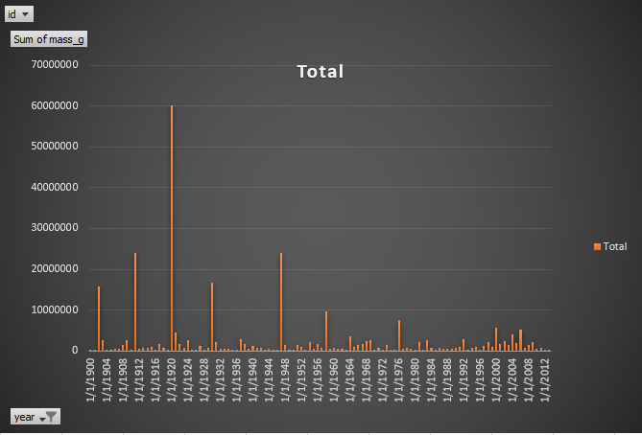
Meteorite Grams By Year

Slide 4
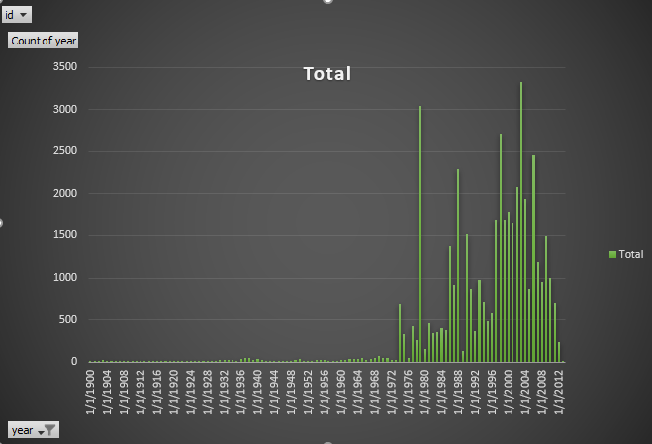
Meteor Count

Slide 5
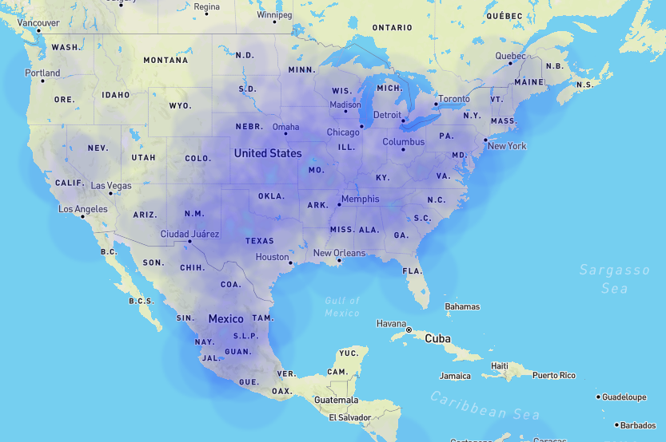
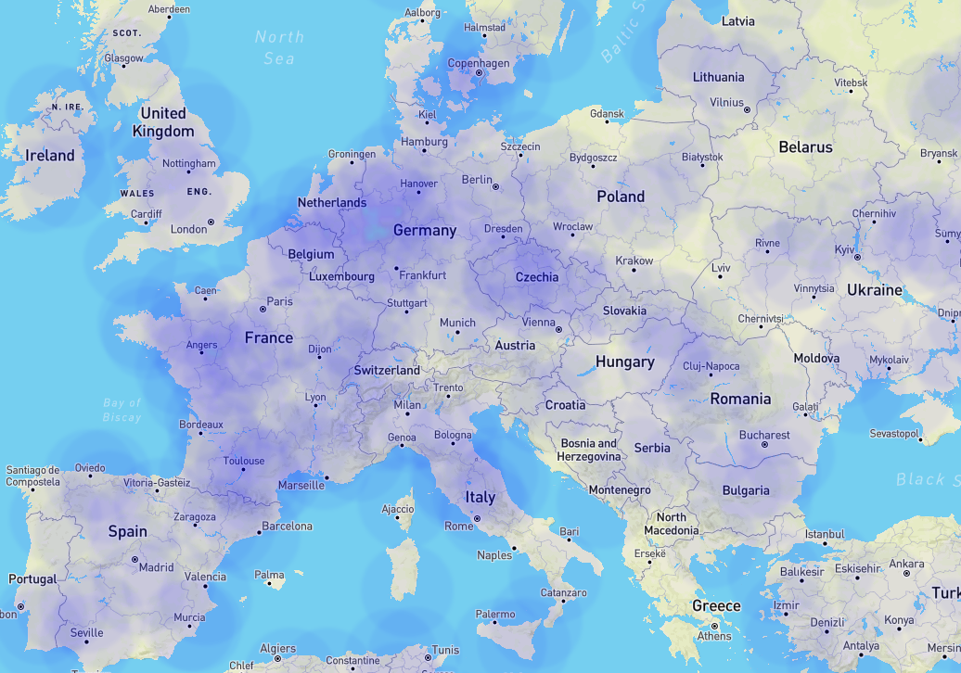
Heat Map Comparisons
North America
Europe

Slide 6
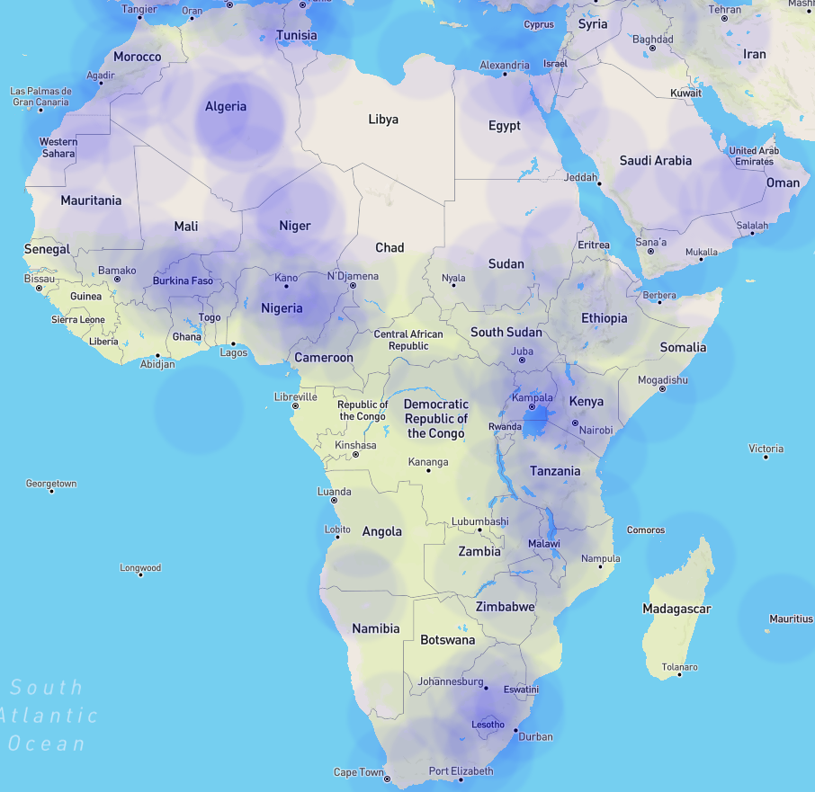
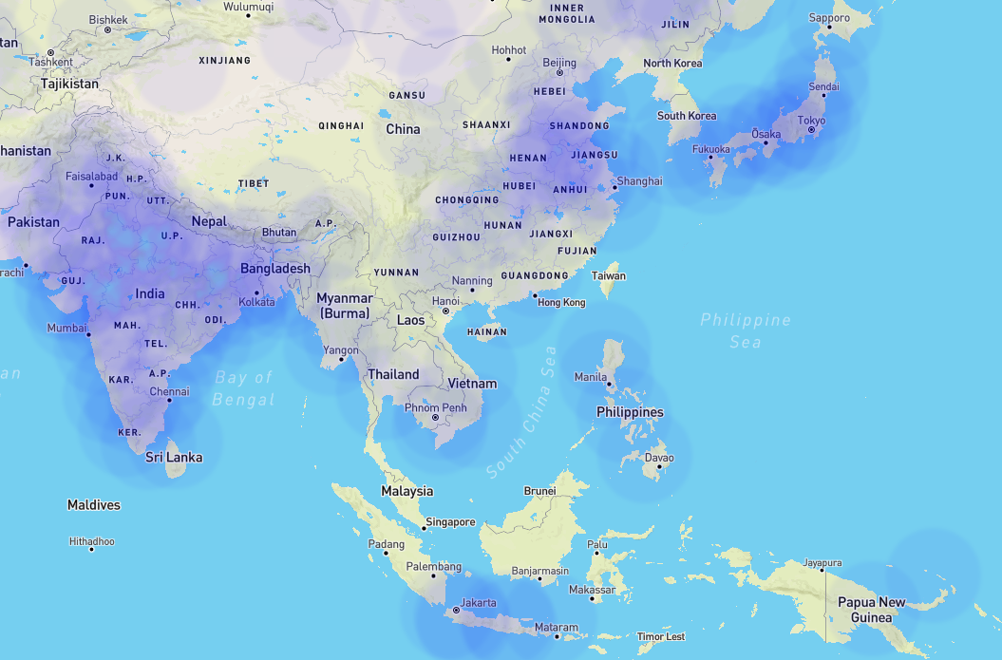
Heat Map Comparisons Cont..
Africa
Asia

Slide 7
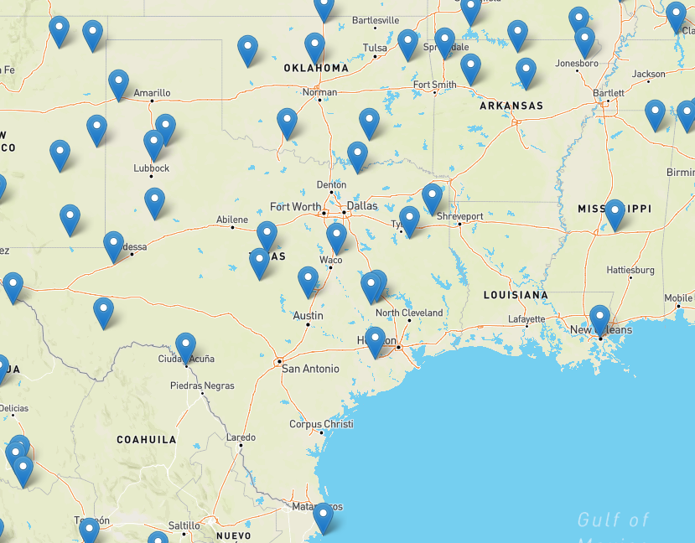
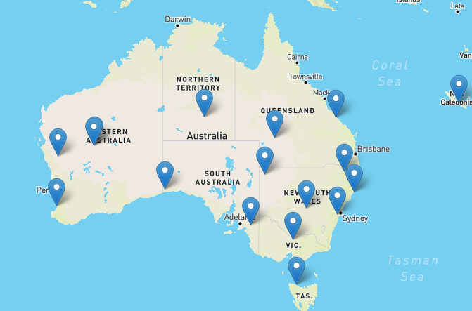
Leaflet Marker Comparison
Australia
United States (Texas, Louisiana, Oklahoma, Arkansas, Mississippi)

Slide 8
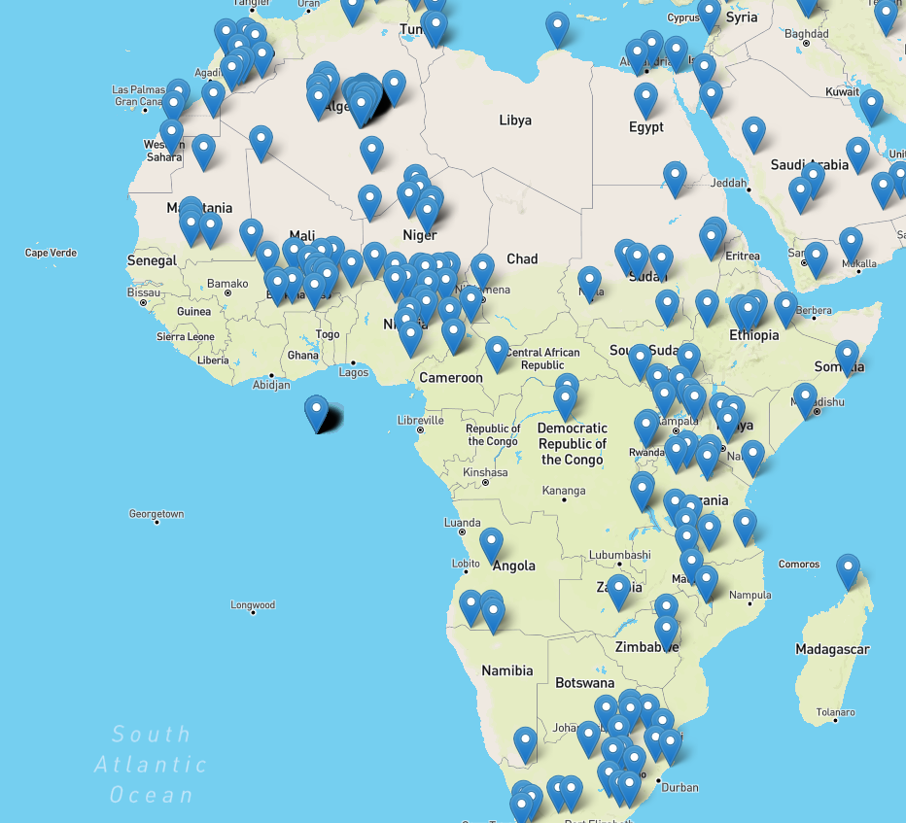
Leaflet Marker Comparison Cont..
Africa

Slide 9
Future Data Analysis

Slide 10
Questions?

